Slide 1
Session 7: Practical Data Processing and Visualization with SYNOP Weather Data

Slide 2
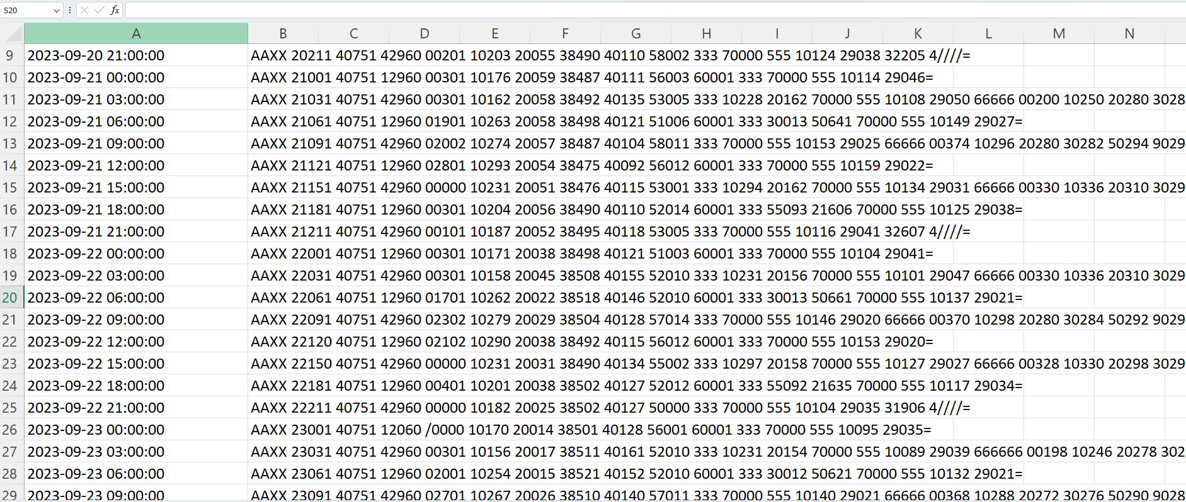
What is the Scenario?

Slide 3
Date and Time
Dew point
Wet temperature
2023-09-21 12:00:00 AAXX 21121 40751 12960 02801 10293 20054 38475 40092 56012 60001 333 70000 555 10159 29022=
2m Temperature
Relative humidity

Slide 4

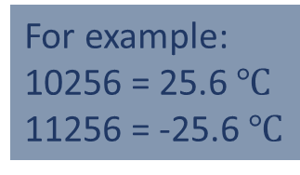
10293
=29.3 $℃$
2023-09-21 12:00:00 AAXX 21121 40751 12960 02801 10293 20054 38475 40092 56012 60001 333 70000 555 10159 29022=
0 := +
1 := -
For example:
10256 = 25.6 $℃$
11256 = -25.6 $℃$

